Slide 1

CSIS 3050 Final Presentation
Alexander Cannell, Ethan Kleinman, Chris Kelly, and Dakota Gray

Slide 2

Methods of security for small businesses
Physical security
Software security
Employee awareness

Slide 3
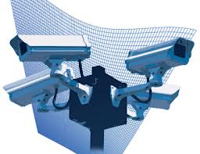
Physical Security
When considering security we also need to be concerned about Physical Security of our system. There is a saying,
"Physical Access equals
complete access to a hacker."
Our first concern always is,
"How is my Data physically
secured."

Slide 4

Logical Security
Consists of software safeguards for an organization's system, including user identification and password access, authenticating, access rights and authority levels. Theses measures are to ensure that only authorized users are
able to access information
on a computer.

Slide 5

White Hat vs Black Hat

Slide 6

Software and Computer security
Antivirus
Firewall
Secure Servers
Keeping computers updated

Slide 7

Employee Awareness
Training to identify attacks
Levels of access
Sensitive Company Information
Internal Theft
Notes:
Training to identify attacks - You need to make employees aware that there are going to many different kinds of risks that they will be vulnerable - These can be as simple as a email with an attached virus or a social engineering attack
Level of access- Providing your company with multiple levels of access makes it so that for example a janitor should not have the same privileges in the company as a System admin
SenstiveInfo- Companies need to have policies that explain to them the type of information that they need to not be shared with others outside the company.
Internal Theft- This is one of the most common examples of what can happen if companies are not explaining to their employees the importance of following their policies. They need to know thatt there will be serious consequences.

Slide 8
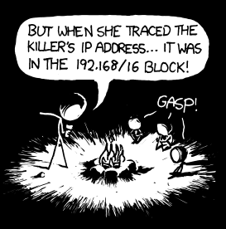
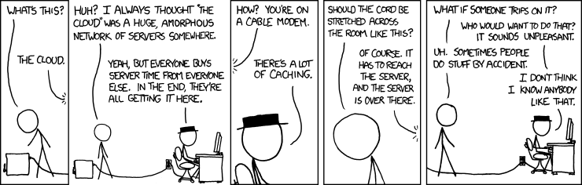
Real Life Stories
Chi Mak
Sent into US in 1978 in order to obtain employment in the defense industry with the goal of stealing US defense secrets. 24 Years Prison
Sergey Aleynikov
Wall Street Company computer programmer
Kexue Huang
Worked for two US companies, sent stolen trade secrets to China and Germany

Slide 9
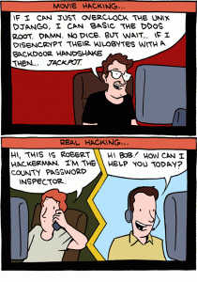
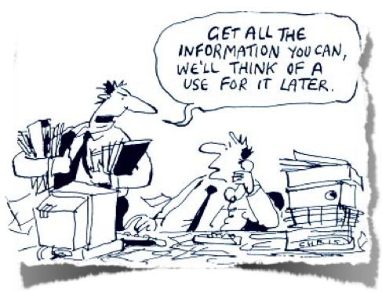
Social Engineering
Sex Appeal
Greed
Vanity
Trust(Implied or Transient)
Compassion
Urgency
(Cisco Annual Security Report 2010)
Notes:
Recent Insider Theft Cases
Wen Chyu Liu, a retired research scientist, was sentenced in January 2012 to 60 months in prison, two years supervised release, a $25,000 fine and was ordered to forfeit $600,000. Liu was convicted in February 2011 of stealing trade secrets from his former employer and selling them to companies in China. Liu conspired with at least four current and former employees, traveled throughout China to market the stolen information, paid current and former employees for material and information, and bribed a then-employee with $50,000 in cash to provide a process manual and other information.
Kexue Huang was employed by two different US companies. He admitted that from 2007 to 2010 he delivered stolen trade secrets from both companies to individuals in Germany and China. The stolen materials were used to conduct unauthorized research to benefit Chinese universities. Huang also pursued steps to develop and produce the trade secrets in China. The aggregated loss from both companies was between $7 and $20 million. Huang pleaded guilty to charges of economic espionage and theft of trade secrets, and was sentenced in December 2011 to 87 months in prison and three years supervised release.
Yuan Li, a former research chemist with a global pharmaceutical company, pleaded guilty in January 2012 to stealing her employer’s trade secrets and making them available for sale through Abby Pharmatech, Inc. Li was a 50% partner in Abby. Between October 2008 and June 2011 Li accessed her employer’s internal databases, downloaded information to her personal home computer, and made them for sale through Abby. She was sentenced to 18 months in prison.
Elliot Doxer sent an e-mail to the Israeli Consulate stating that he was willing to provide information from his employer that might help Israel. An undercover FBI agent posing as an Israeli intelligence officer spoke to Doxer and established a “dead drop” where the two could exchange information. For the next 18 months, Doxer visited the dead drop at least 62 times. Doxer provided customer and employee lists, contract information, and other trade secrets. He pleaded guilty to one count of foreign economic espionage and was sentenced in December 2011 to six months in prison, six months home confinement, and fined $25,000.
Sergey Aleynikov worked as a computer programmer for a Wall Street company. During his last few days at that company, he transferred 32 megabytes of proprietary computer codes — a theft that could have cost his employer millions of dollars. He attempted to hide his activities but the company discovered irregularities through its routine network monitoring systems. In December 2010, Aleynikov was found guilty of theft of trade secrets.
Michael Mitchell became disgruntled and was fired from his job due to poor performance. He kept numerous computer files with his employer’s trade secrets; he entered into a consulting agreement with a rival Korean company and gave them the stolen trade secrets. In March 2010, he was sentenced to 18 months in prison and ordered to pay his former employer over $187,000.
Shalin Jhaveri gave trade secrets to a person he believed was an investor willing to finance a business venture in India, and confirmed that the information he had taken from his employer was everything he needed to start the business. In January 2011, he was sentenced to time served (one year and fifteen days), three years probation, a$5,000 fine, and a $100 Special Assessment.
Greg Chung spied for China from 1979-2006. Chung stole trade secrets about the space shuttle, the Delta IV rocket and the C-17 military cargo jet for the benefit of the Chinese government. Chung’s motive was to “contribute to the Motherland.” He stole hundreds of thousands of documents from his employer. He traveled to China under the guise of giving lectures while secretly meeting with Chinese agents. He also used Mak (below) to transfer information back to China. In February 2010 he was sentenced to over 15 years in prison.
Chi Mak admitted that he was sent to the United States in 1978 in order to obtain employment in the defense industry with the goal of stealing US defense secrets, which he did for over 20 years. He passed information on quiet electric propulsion systems for US submarines, details on the Aegis radar system, and information on stealth ships being developed by the US Navy. The Chinese government tasked Mak to acquire information on other technologies. Mak recruited family members to encrypt and covertly courier information back to China. In May 2007, Mak was convicted of conspiracy, failing to register as an agent of a foreign government, and other violations. He was sentenced to over 24 years in prison.

Slide 10
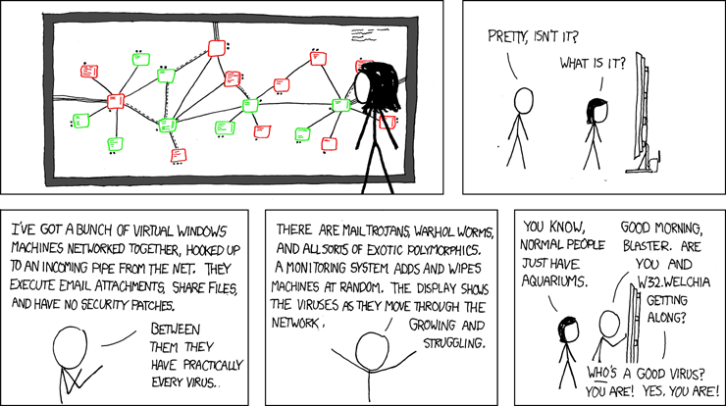

The End!
Any Questions?

